Slide 1
Crime Rate Prediction
Project Guide:
J.Uma Devi AP/CSE
Team Members:
R.Vashni Bekasha
P.Subha Sri
M.Veeralakshmi
M.Selva Sobika

Slide 2
CONTENT
Abstract
Literature Survey
Proposed System
System Architecture
Module Description
Module Implementation
Coding
Output
Performance Comparison Chart
Advantages
Disadvantages
Future Enhancement
Conclusion

Slide 3
ABSTRACT
Crime is an act that is prohibited by law and is punishable by a fine, imprisonment, or other legal action.
Crime prediction is significant to determine increase or decrease in crime rate from preceding years.
Sophisticated ML algorithms and data-driven methods can be used to identify patterns in data to detect and predict criminal activities.
Our innovation aims to enhance public safety, promoting a secure community through engaged citizens who take an active role in crime prevention.

Slide 4
LITERATURE SURVEY
Crime Prediction using Machine Learning (2021): The results showed that the Random Forest Classifier achieved the highest accuracy.
Spatio-Temporal Crime Prediction (2019): The results showed that the model achieved high accuracy in predicting crime occurrence.
Crime Prediction using Social Media (2019): The results showed that social media data can be a valuable source for crime prediction.
Crime Rate Prediction using KNN (2018): This system looks at how to convert crime information into a data-mining problem to help detectives solve crimes faster.

Slide 5
PROPOSED SYSTEM
Data Preprocessing: The data is prepared in the correct format for analysis.
Random Sampling: The data has been splitted into two parts: training data (70%) and testing data (30%).
Model Creation: The dataset has been analyzed using five different models: support vector machine, nearest neighbor, decision tree, random forest, and neural network.
Model Selection: Based on the defined goals and model performance, random forest model has been selected.
Model Deployment: The model has been deployed for prediction using flask web technology.

Slide 6
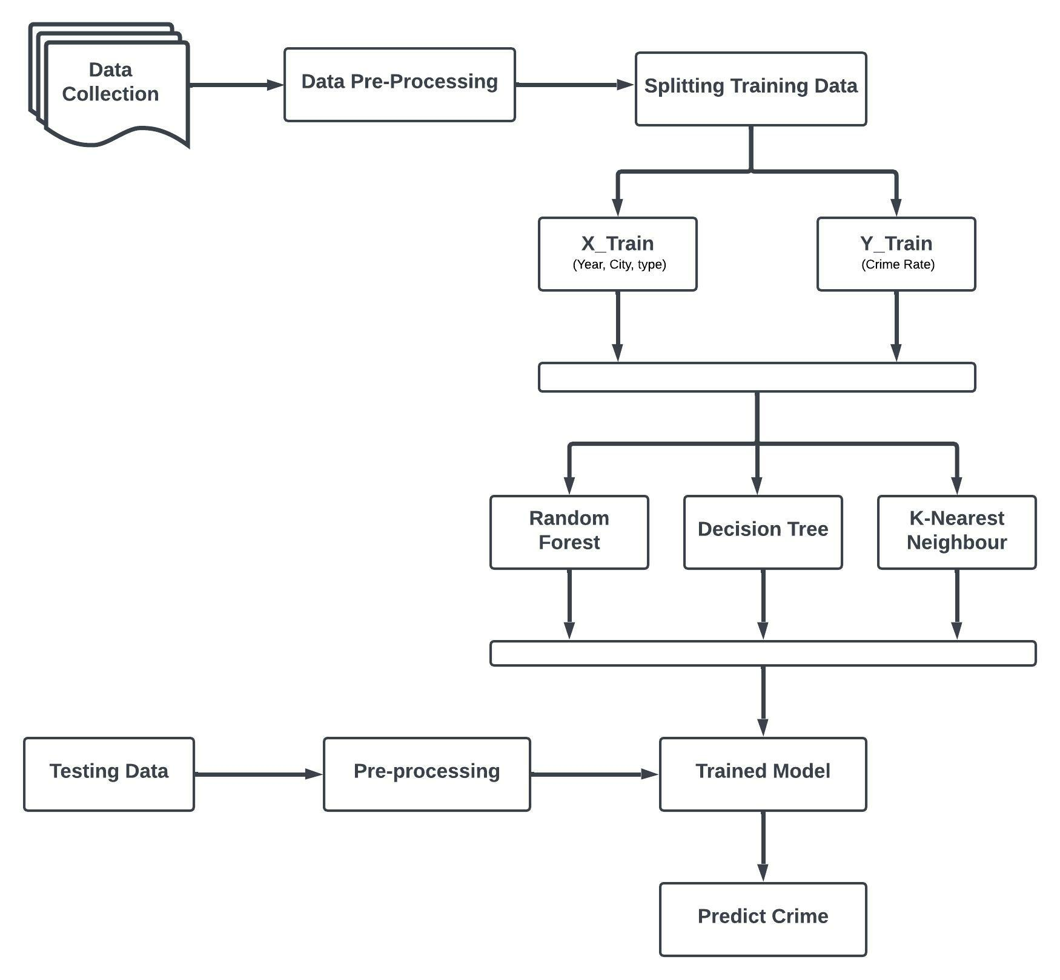
SYSTEM ARCHITECTURE

Slide 7
MODULE DESCRIPTION
User Interface: This stage involves collecting user inputs such as city, crime type and year also shows prediction results with city name, crime type.
Input Handling: To receive and process form data from the user. Retrieves values for city, crime type and year.
Data Preprocessing: This stage involves cleaning and transforming raw crime data into a suitable format for analysis and ensuring accuracy.
Model Training: Implementing machine learning algorithms to train on historical crime data, which helps in understanding patterns and predicting future crime occurences accurately.

Slide 8
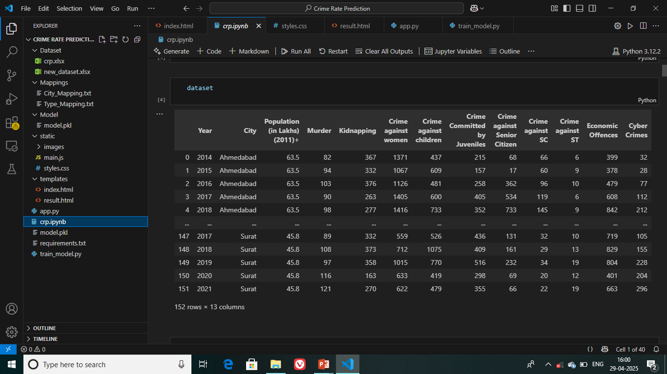
MODULE IMPLEMENTATION
1.Data Collection Module:

Slide 9
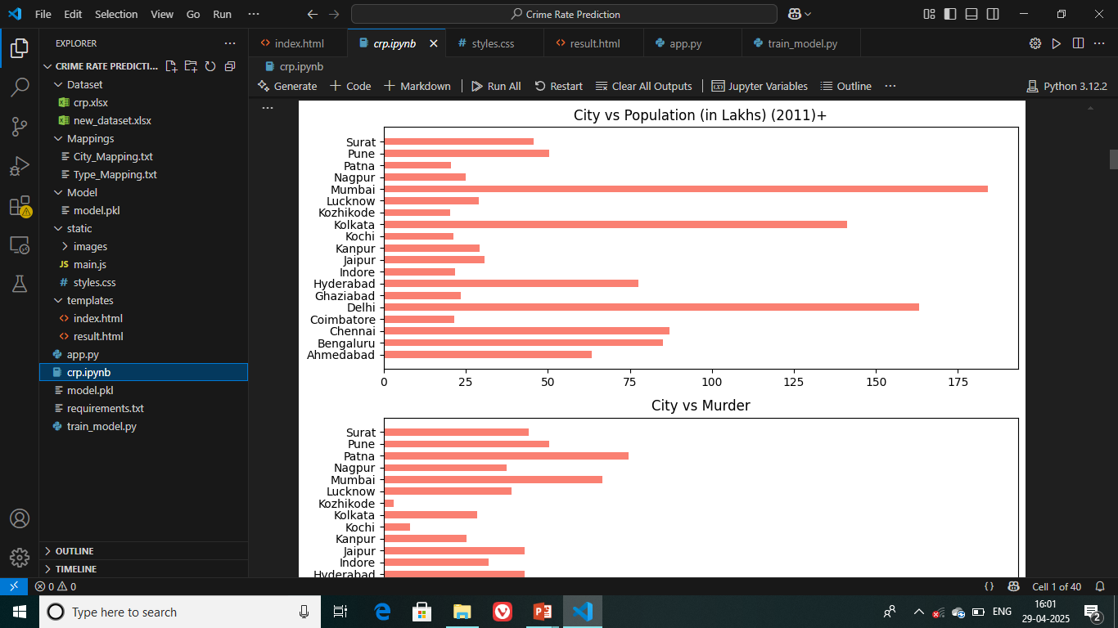
MODULE IMPLEMENTATION
2.Visualisation Module:

Slide 10
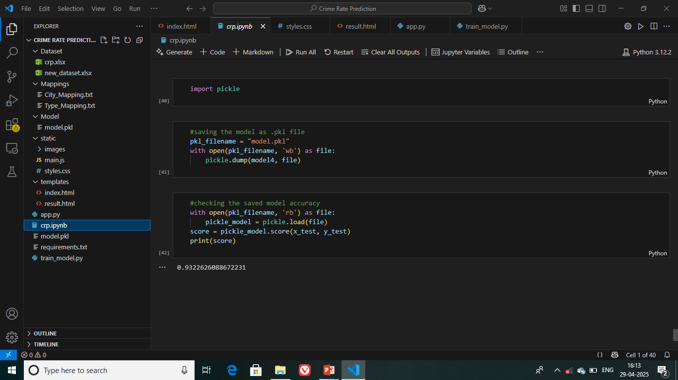
MODULE IMPLEMENTATION
3.Model Saving and Loading Module:

Slide 11
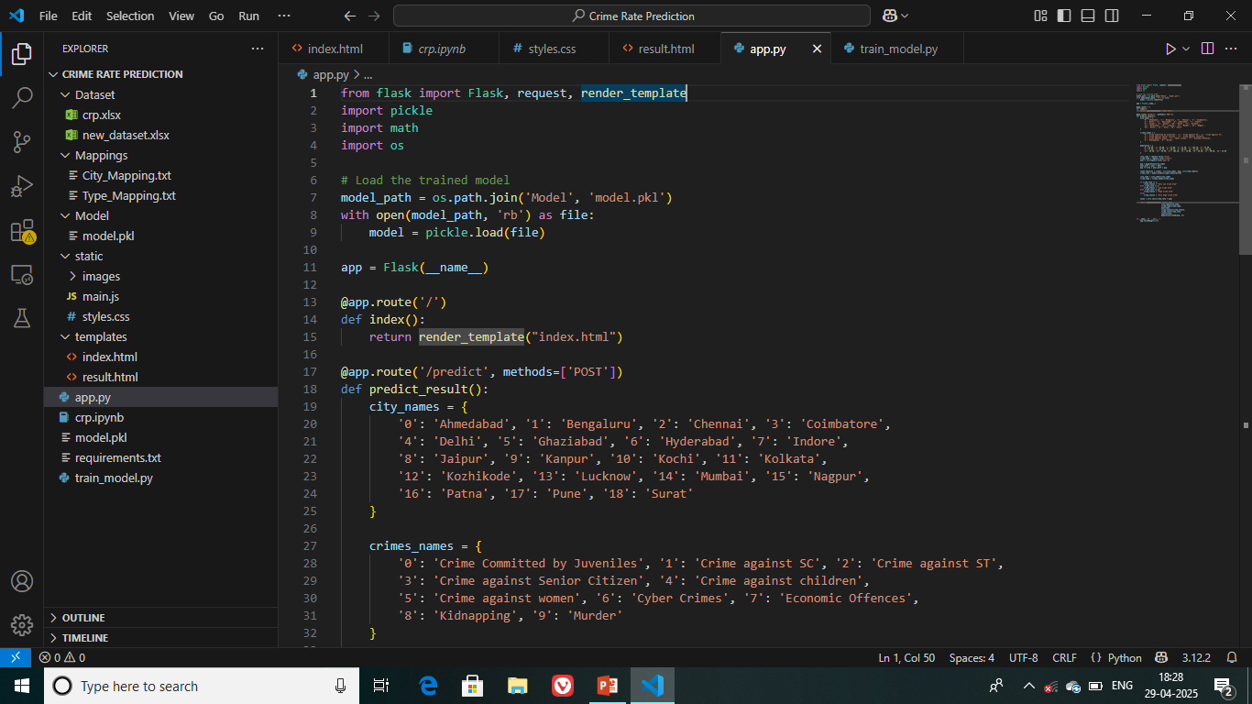
CODING

Slide 12
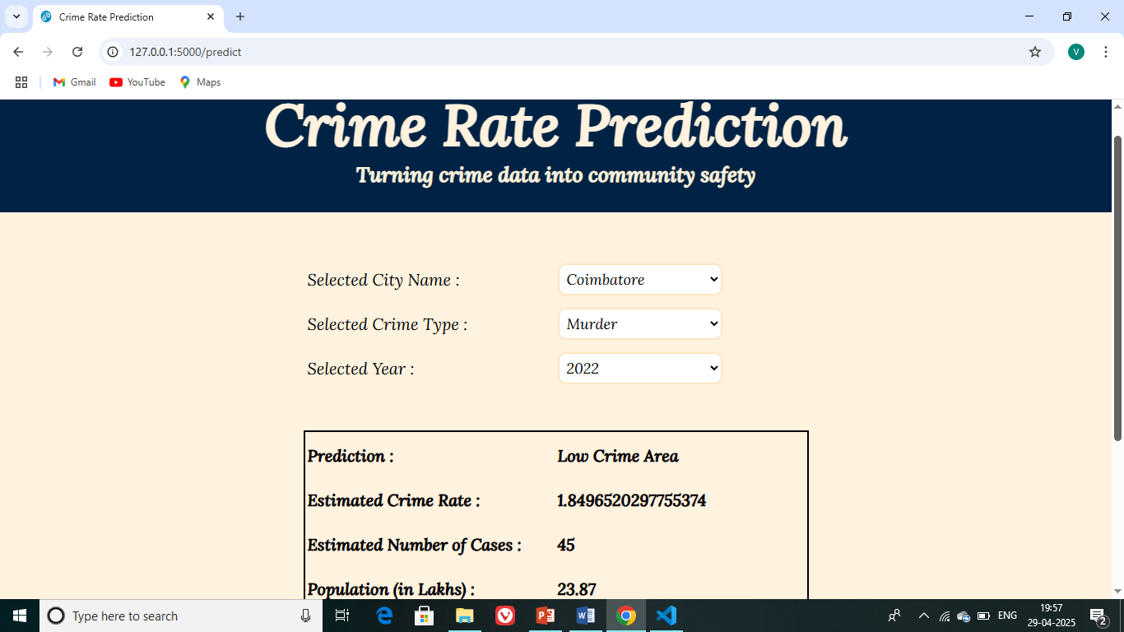
OUTPUT

Slide 13
PERFORMANCE COMPARISON CHART
MODEL | ACCURACY (%)
Random Forest | 93.20
Decision Tree | 88.00
K-Nearest Neighbors | 55.00
Support Vector Machine | -17.00
Neural Network | 90.77

Slide 14
ADVANTAGES
Predictive Capability: Helps forecast crime rates using historical data, enabling proactive measure by authorities.
Machine Learning Integration: Utilizes widely used algorithms, showcasing fundamental ML applications.
Data-Driven Decision Making: Encourages the use of real crime data to derive insights that can guide law enforcement strategies.
Open Source and Reproducible: The Code is publicly available, allowing others to build upon or replicate the project.

Slide 15
DISADVANTAGES
Model Specificity: Only basic ML models are used, more advanced models could yield better results.
Limited Feature Engineering: There appears to be minimal exploration of feature selection, interaction effects, or handling of complex correlations.
Lack of Real-Time Integration: The model doesn’t seem to incorporate real-time or streaming data for up-to-date predictions.
Lack of Temporal Analysis: The project doesn’t appear to consider time-series analysis or seasonal trends in crime, which are crucial for understanding.

Slide 16
FUTURE ENHANCEMENT
Web-Based Platform: Develop an interactive website for real-time crime prediction and visualization.
Integration of Real-Time Data: Incorporate live inputs from social media, emergency calls, and surveillance systems.
Geospatial Crime Mapping: Add location-based heatmaps for identifying crime hotspots using GIS.
Explainable AI: Include model interpretation tools to explain predictions for better trust and transparency.

Slide 17
CONCLUSION
Crime rate prediction has become an important tool for law enforcement agencies to help them focus their resources in high-crime areas.
By focusing their resources in the right areas, police officers can help reduce the overall crime rate in a community.
As a result of machine learning technology, finding relationships and patterns between various data has become easier.
The model prediction of crime rate and data visualization helps in analysis of data set and prediction of crimes.
The model helped in understanding different crime datasets that can be used in implementing the factors that can help in keeping society safe.

Slide 18
THANK YOU

